Slide 1
Data-Spark : Illuminating Insights for Global Electronics
BY: Prachi Choudhary

Slide 2
PROBLEM STATEMENT
Global Electronics, a leading retailer of consumer electronics, has provided you with several datasets containing information about their customers, products, sales, stores, and currency exchange rates. The company seeks to leverage this data to better understand their business and identify areas for improvement.

Slide 3
AIM
By analyzing the data we aim to identify the key insights that will enhance the marketing strategies, optimize inventory management, and improve sales forecasting. This will help tailor marketing campaigns, develop better products, plan effective promotions, and decide on store expansions and optimizations.
Currency exchange rates will also helps in better analzsing the International pricing of the product.

Slide 4
STEPS FOLLOWED
DATA CLEANING AND PREPARATION
DATA CLEANING :Check for the missing values (to see if any datasets are empty).
CONVERT DATATYPES: Checking the correct format of the columns.
MERGING DATASETS: Merging and joining of the datasets on the basis of the common information .
LOAD DATA INTO SQL
Creating tables into SQL DB and inserting values into it using INSERT INTO STATEMENTS for each dataset.
VISUALITIONS
Used POWER BI for creating interactive visuals .
Connecting SQL and POWER BI.(It connects to your SQL database and import the cleaned data).
Perform DataModelling .
Creating them into graphs, bar graphs, charts , tables etc to visualize the trends and patterns.
Run different queries to get useful insights from the data.

Slide 5
ANALYSIS REPORT:
Customer Analysis
Product Analysis
Sales Analysis
Store Analysis

Slide 6
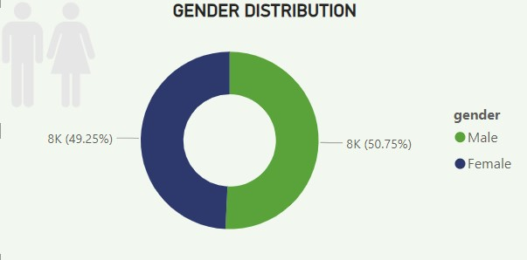
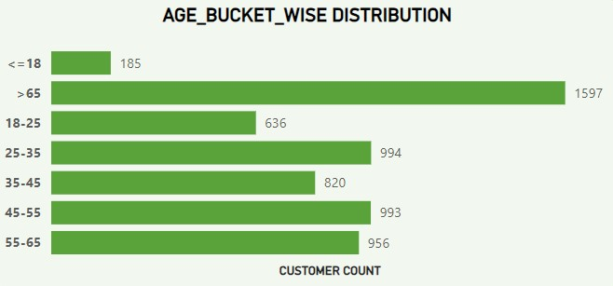
Customer Analysis
CUSTOMER ANALYSIS
Gender Distribution:
We can see that both male and female are approximately equal(as global sex ratio is 100 females to 101 male).It implies that gender distribution doesn’t makes any difference.
Age Wise Distribution:
This bar graph show that the customer count is maximum from age group above 65 and least for age group 18-25 years.

Slide 7
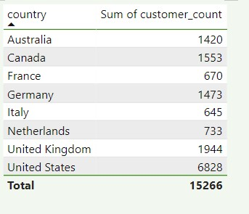
Gender Analysis:
From the table we can analise the intensity of Sales around the World using customer count.
It implies it is maximum for USA and minimum for Italy.

Slide 8
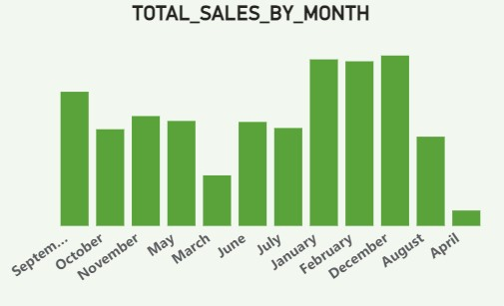
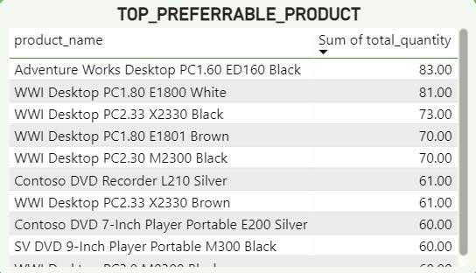
SALES ANALYSIS
Monthly sales:
We can see the highest sales are there in Jan, Feb and Dec for which the inventory should be ready to face the hike in demand.
The April and march month has recorded the lowest sales which can be overcome by doing proper marketing and maintaining good product portfolio
Top Performers Products:
Desktops are the top products and all the colours are in demand followed by DVD Players.These contributes to the max revenue.

Slide 9
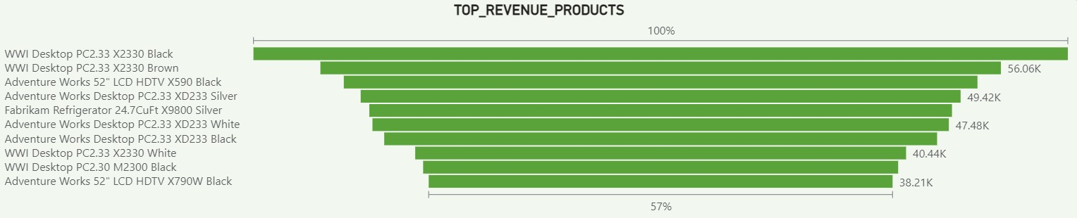
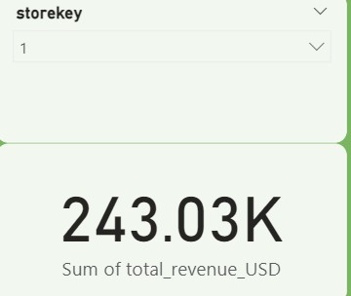
Sales Analysis
STORE_KEY ANALYSIS:
It implies the sum of total revenue in USD of the selected storekey.

Slide 10
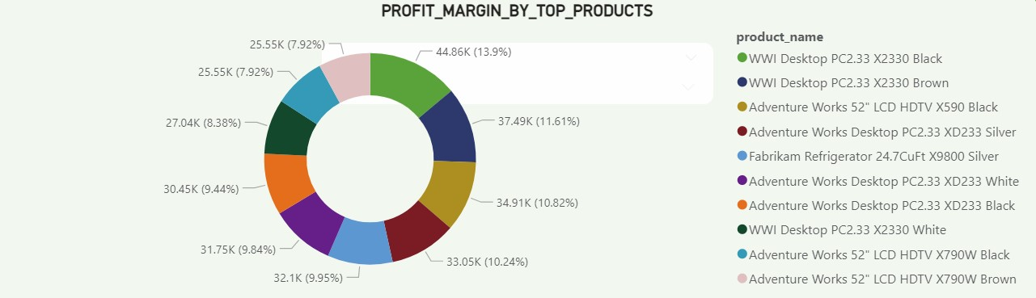
Product Analysis
PRODUCT ANALYSIS
Profit Margin by Top Products:
From the Donut chat that has been shown for the top 10 products with the max profit margin is Computers and Desktops.

Slide 11
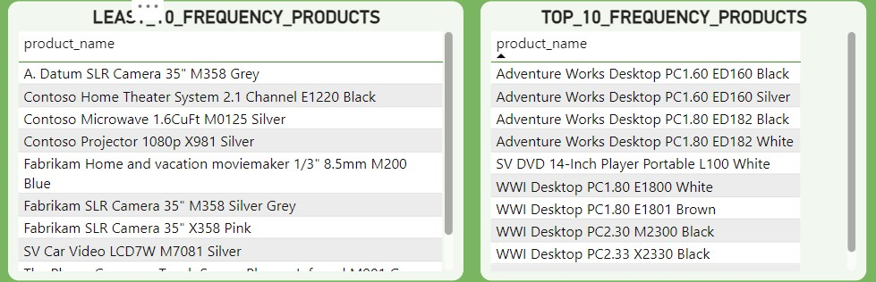
Sales Analysis
Least 10 Frequency Products:
We can see that the larger proportion of the least 10 products are from home appliances, camera segment.
Making the competitor analysis will help us understand the gaps in our current products quality .
Top 10 Frequency Products:
The top selling products are from the Desktop and Players(DVD).
It’s recommended to maintain sufficient inventory to meet the customer demand.

Slide 12
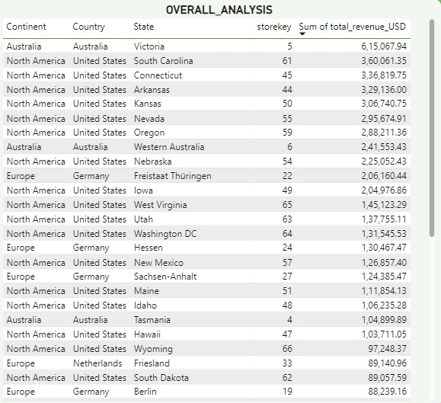
STORE ANALYSIS
Overall Analysis:
The maximum revenue is from North America.
It also describes Australia has very less number of stores in respect to the size of the continent.
It implies we need to more work on Australia in setting up new stores to hike the profit .

Slide 13
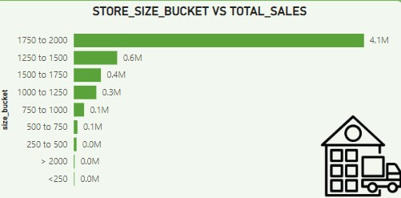
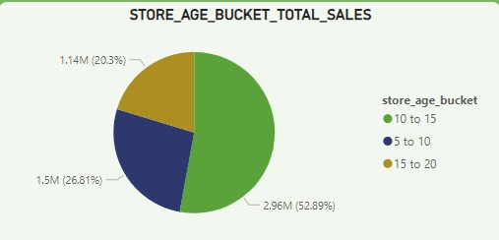
Store Analysis
Store Size analysis:
We can see that the stores with the area between 1750-2000 are contributing to more than 50% of the entire sales.
We can see the stores with the highest area are not the highest selling . While expanding further store size must be considered.
Store Age analysis:
If the age of the store is between 10-15 then they are contributing to the highest amount of sales(52.89%) of the total sales .

Slide 14
Thank You

